Slide 1
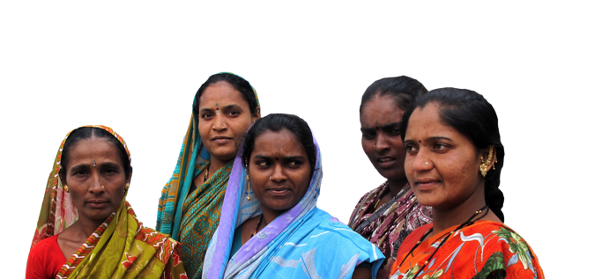










SAMVEDANA PLUS | Preventing Intimate Partner Violence Against Female Sex Workers
Challenges in measuring violence among female sex workers and their intimate partners:
Learnings from Samvedana Plus intervention
Ravi Prakash, PhD
Karnataka Health Promotion Trust, Bangalore, India
What Works Annual Capacity Development & Scientific Meetings
6-9 September, 2016, Dubai

Slide 2
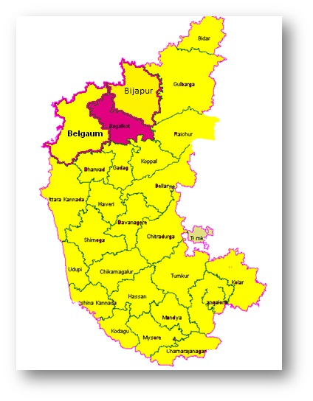
About the intervention
Samvedana Plus, a three year intervention (2015-2018) addressing violence and HIV risk in the intimate partnerships of female sex workers (FSWs)
47 villages in Bagalkote district of north Karnataka, south India
Reaching about 800 FSWs and their intimate partners (IPs) in 2 phases
    Majority of them from the rural areas, belong to marginalized communities and have been dedicated to sex work as Devadasi
A multi-layered intervention engaging individuals -FSWs and their IPs, community and the sex work collective
SAMVEDANA PLUS | Preventing Intimate Partner Violence Against Female Sex Workers

Slide 3

Evaluation design
Cluster-randomised control trial design with waitlist control, using the village as the unit of randomisation
  Cross-sectional behavioural quantitative surveys at three time-points with FSWs and two point surveys with their IPs
  Three rounds of qualitative longitudinal case studies with FSW and their IPs
Provides an opportunity to compare the response on experience/perpetration of violence among members of the same couple
SAMVEDANA PLUS | Preventing Intimate Partner Violence Against Female Sex Workers

Slide 4
Data
  Quantitative and qualitative baseline data collection among FSWs and their IPs
    Quantitative study: During June2014-February 2015
      FSW: June 2014; IP: Feb 2015
      Included 620 FSWs and 504 IPs
    Qualitative study: During July-October 2014
      23 FSWs and 15 IPs; including 10 couples
Midline data collection: currently ongoing
Detailed information collected from FSWs on victimization and from IPs on perpetration of different forms of violence
SAMVEDANA PLUS | Preventing Intimate Partner Violence Against Female Sex Workers

Slide 5
Victimization/perpetration of violence in past 6 months: Baseline findings
Large differences in levels of violence reported by FSWs and IPs
  Differences also noted among couples reporting severe violence
  Level of violence perpetration reported by men is highest ever reported in literature
Moderate physical violence only: pushing, shaking, slapping once or few times
Severe physical/sexual violence: Many times moderate violence and/or any severe physical and/or sexual violence such as throwing something to hurt, hitting, dragging, beating, kicking, choking, threatening using knife or gun , forced sex, asking to do something degrading/humiliating

Slide 6
Concordance in violence reporting between couples
  The differences in violence equally pronounced among couples:
    Just 26% FSWs and their partners mentioned about same level of violence
SAMVEDANA PLUS | Preventing Intimate Partner Violence Against Female Sex Workers

Slide 7
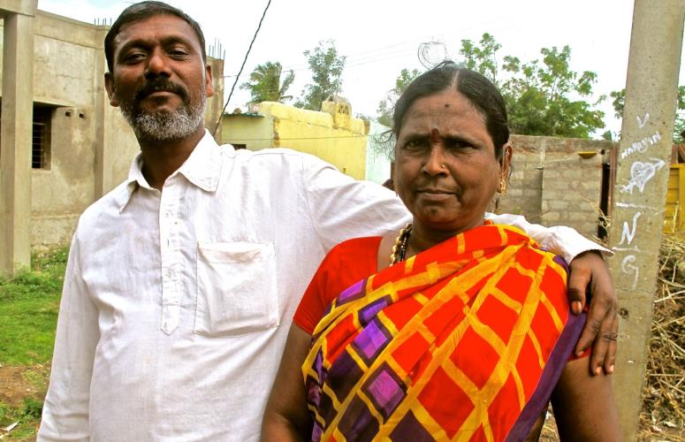
How to explain the anomaly?
Explored various hypotheses:
  Is perpetration of violence being over-reported by IPs?
    Comparison of violence to the spouse and the sex work partner
    Discussions with sub-sample of men and field staff to explore their perceptions
  Did the IPs understand the questions correctly?
  Did FSWs under-report levels of violence?
SAMVEDANA PLUS | Preventing Intimate Partner Violence Against Female Sex Workers

Slide 8
Hypothesis 1:
Is violence being over-reported by IPs?
  Men report equally high levels of violence against their wives as against their FSW lovers
SAMVEDANA PLUS | Preventing Intimate Partner Violence Against Female Sex Workers

Slide 9
Hypothesis 1:
Is violence being over-reported by IPs?
  What do the qualitative findings suggest?
  Men acquire a sense of ownership over a SW as soon as she becomes a lover
  His expectation towards her changes: he wants her to be moral and honorable; to quit sex work and not have other sexual partners
  If she continues sex work, this is cause for physical reprimand
Participatory discussions with IP revealed:
  Every man in the group perceived that partner beating is justified to correct ‘her mistakes’
  Men lose social status if they do not beat in response to perceived transgressions
Did this expectation influence the answers of IPs?
SAMVEDANA PLUS | Preventing Intimate Partner Violence Against Female Sex Workers

Slide 10
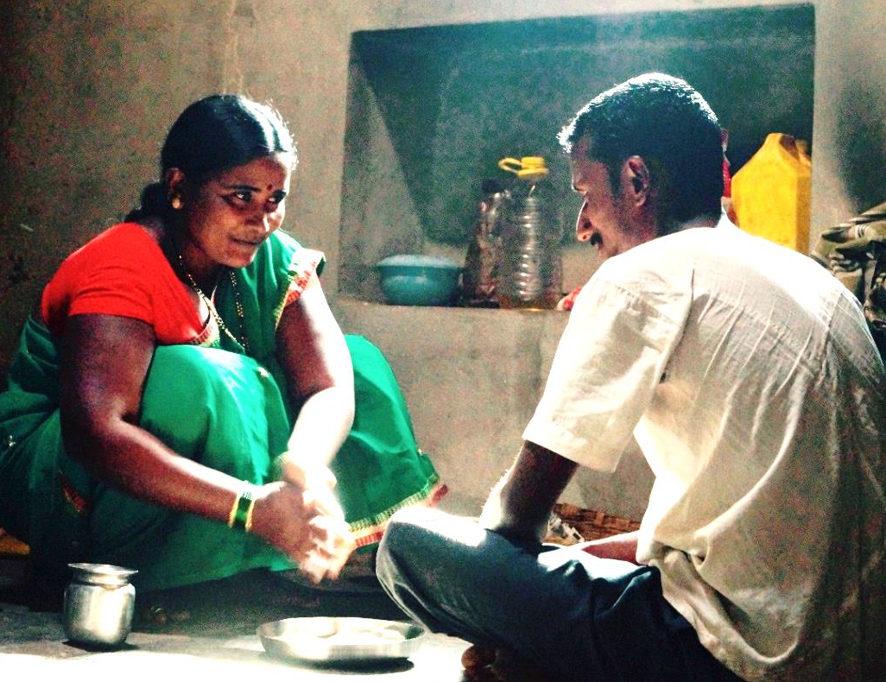
Hypothesis 1: Is violence being over report by IPs?
What did the field staff find?
Field staff strongly suspect over-reporting of violence by men as a result of:
  male bravado and urge to demonstrate masculine power
  violence seen as very casual act and IPs believe it to be their right to discipline their FSW lovers and use violence because they cover financial needs of FSWs in some cases
SAMVEDANA PLUS | Preventing Intimate Partner Violence Against Female Sex Workers

Slide 11
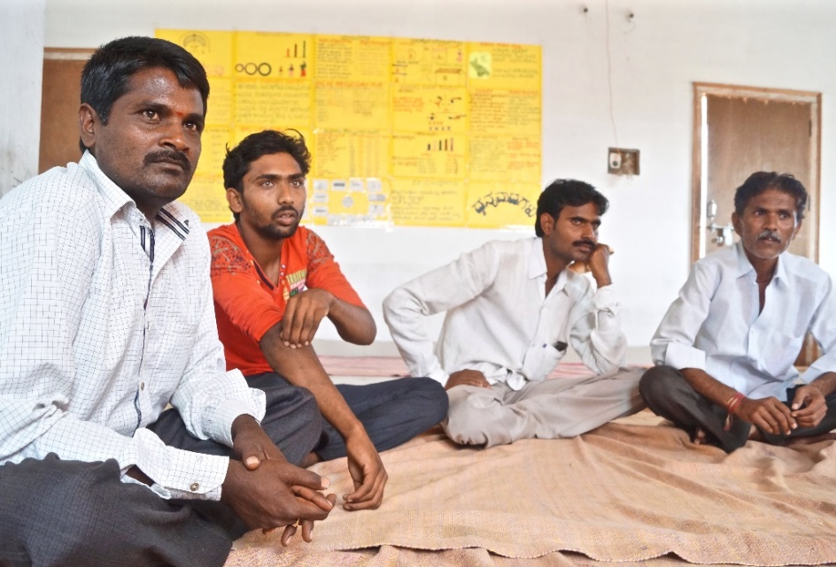
Hypothesis 2:
The respondents misunderstood the questions
Cognitive interviews with IPs to explore whether they understood the questions correctly?
  Generally, poor level of comprehension
  When asked to re-phrase questions in own words, many errors were introduced
  Poor attention to the different acts of violence
  Difficulty in understanding certain terms
SAMVEDANA PLUS | Preventing Intimate Partner Violence Against Female Sex Workers

Slide 12
Hypothesis 2:
The respondents misunderstood the questions
Example 1:
I: I am going to ask you a question. Think of your intimate partner. ‘Have you slapped or shoved her in the last 6 months?’ Repeat this question.
P: Yes, I did. I have beaten her.
I: No, you just repeat the question.
P: ‘Have you slapped or shoved your lover in last 6 months?’
I: Okay, fine. How would you ask a friend this question?
P:I will ask him ‘have you slapped or beaten or quarreled with her?’
Example 2:
I: We move to next question. The next question is, ‘have you hit her with your fist or something else that could hurt her in last 6 months?’ Repeat this question.
P: ‘Have you shoved her or hit her with something in last 6 months?’ (missing: with fist or something that could hurt her)
I: This is what you understood. Okay. Did you get what I asked you?
P: I understood what you said but I am unable to repeat the same.
I: How would you ask a friend this question?
P: ‘Have you beaten her or had fight recently?’ This way…

Slide 13
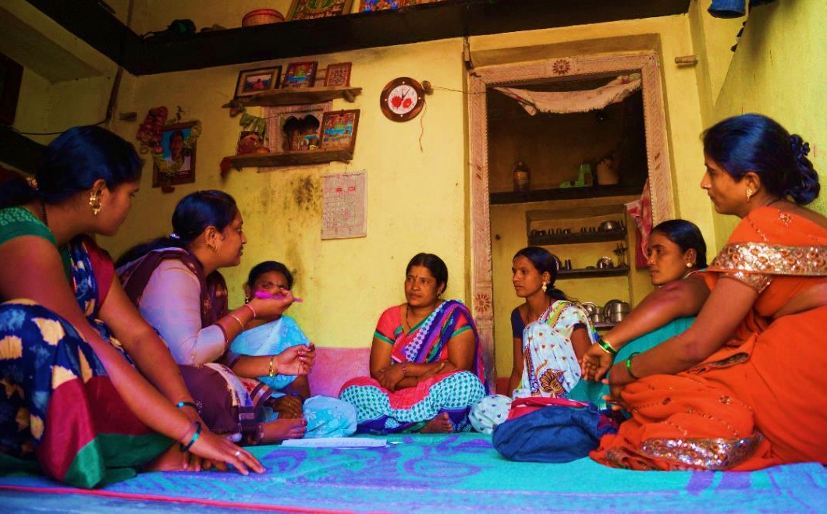
Hypothesis 3:
Female sex workers under-reported violence
Extremely high acceptance of violence
  94% FSWs perceived ‘women should tolerate violence for the sake of children’
  93% perceived ‘women should tolerate violence to keep her family together’
  90% FSW perceived ‘women’s role in relationship is to serve her partner’
May have resulted in FSWs discounting many acts of violence
SAMVEDANA PLUS | Preventing Intimate Partner Violence Against Female Sex Workers

Slide 14
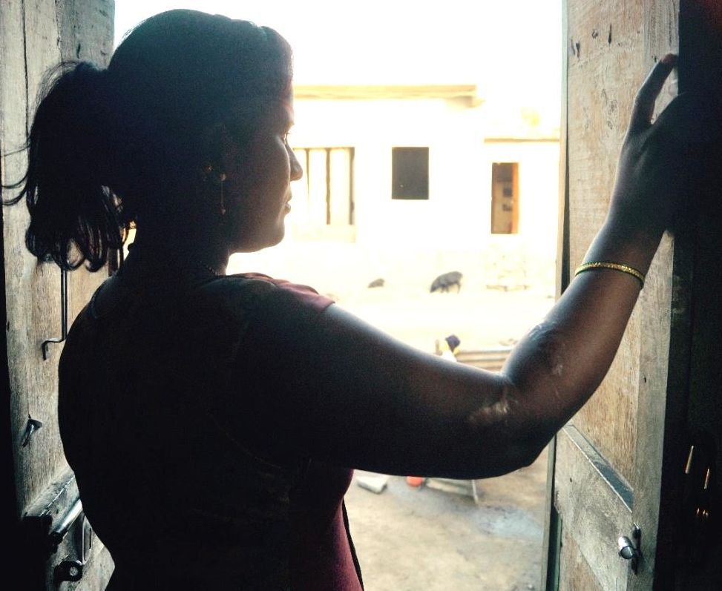
Take home messages….
A sense of over-reporting of violence by men due to multiple reasons
The discrepancy is an important standalone finding that demonstrates the complexities of doing interventions and research on relationships that are not socially sanctioned
The research highlights a whole range of new reporting biases
  need to further explore and understand
  apart from learning a lot about social expectations influencing behaviour, findings open up a new avenue to explore on normative reporting

Slide 15
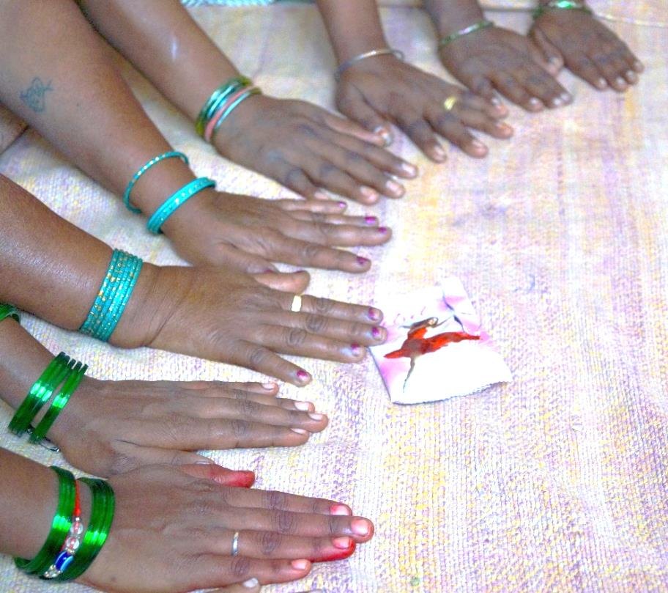
Work in progress...
Further analysis of cognitive interviews to better understand the issue
Further exploration of the complexity of the relationship in midline qualitative research
Use of alternative methodologies like Polling Booth Survey (PBS) to minimize the reporting bias
Compare the violence estimates from face-to-face interview and PBS to arrive at the amount of under/over reporting of violence-
  to be further used for estimating the intervention effect
Lowndes, CM et al., (2011), Polling Booth Surveys: A Novel Approach for Reducing Social Desirability Bias in HIV-Related Behavioural Surveys in Resource-Poor Settings, AIDS Behaviour, DOI 10.1007/s10461-011-0004-1
SAMVEDANA PLUS | Preventing Intimate Partner Violence Against Female Sex Workers

Slide 16
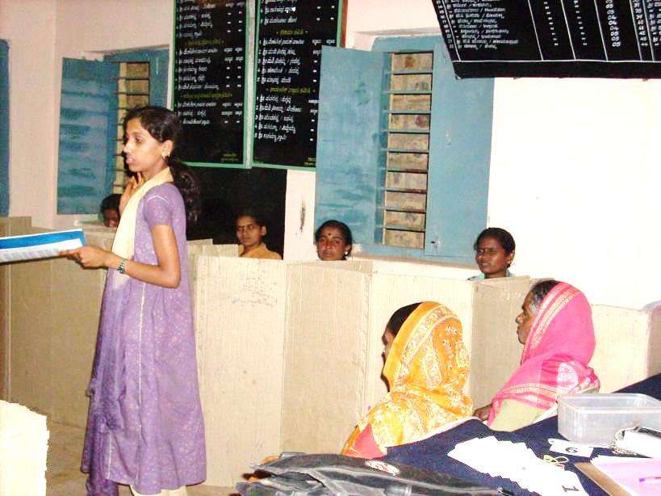
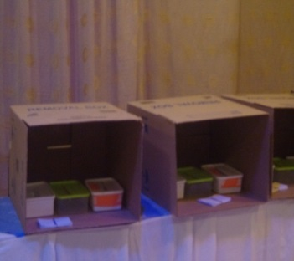
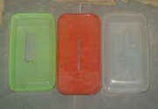
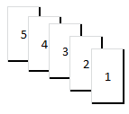
Pooling Booth Survey (PBS)
PBS is a refined method over the face-to-face interview to collect information on behaviour and practices related to sensitive issues influenced by social desirability bias
It is a group interview method which involves confidential reporting through putting the responses in a ballot box
As a result of group approach, responses remain anonymous and unlinked resulting into more accurate responses
  reduced social desirability bias in responses
SAMVEDANA PLUS | Preventing Intimate Partner Violence Against Female Sex Workers

Slide 17
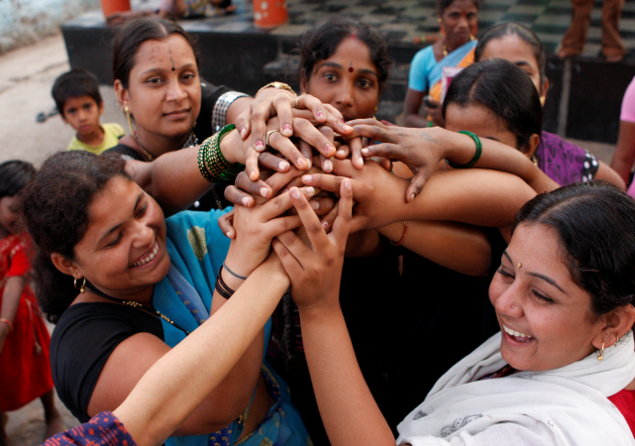



THANK YOU
SAMVEDANA PLUS | Preventing Intimate Partner Violence Against Female Sex Workers

